Slide 1
Impact of Social Sciences, Humanities and Arts Conference
The Parallel Session on:
Impact Support and Leadership
13 October, 2021

Slide 2
Impact of Social Sciences, Humanities and Arts
13-15 October, 2021
Toby Smith (Chair): Vice President for Science Policy & Global Affairs at the Association of American Universities, USA
Rick Delbridge: Professor of Organizational Analysis at Cardiff Business School & co-convenor of the Centre for Innovation Policy Research, Wales, UK
Antonia Caro Gonzalez: Impact Senior Advisor & Practitioner, Spain
Overview of the Speakers
#SSHA21

Slide 3
Impact of Social Sciences, Humanities and Arts
13-15 October, 2021
Toby Smith
Vice President for Science Policy & Global Affairs at the Association of American Universities, USA
#SSHA21

Slide 4
SS&H Impact Support and Leadership
Tobin L. Smith @SciPolGuy
Association of American Universities
AESIS Impact of Social Sciences & Humanities 2021
October 13, 2021

Slide 5
What is Impact?
Scientific/Academic Impact
Economic and Social Impact

Slide 6
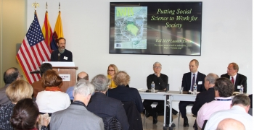
Putting SS&H to Work for the Public Good
Historically the focus of the SS&H community has been largely on achieving scientific impact.
We need to put SS&H to better use to advance societal interests.
Ken Prewitt, “Retrofitting the Social Sciences for the Practical & Moral,” Issues in Science and Technology, Fall 2019.
Leadership and additional institutional support will be required to accomplish this goal.

Slide 7
What Does Institutional Support & Leadership Look Like?
Commitment from senior university leaders
Money - seed funds, challenge grants, etc.
Infrastructure
Training/other support
Rewards and recognition

Slide 8
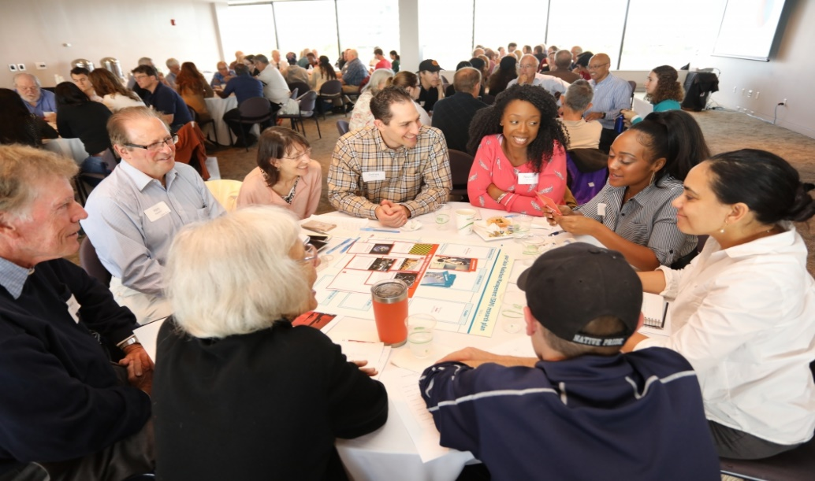
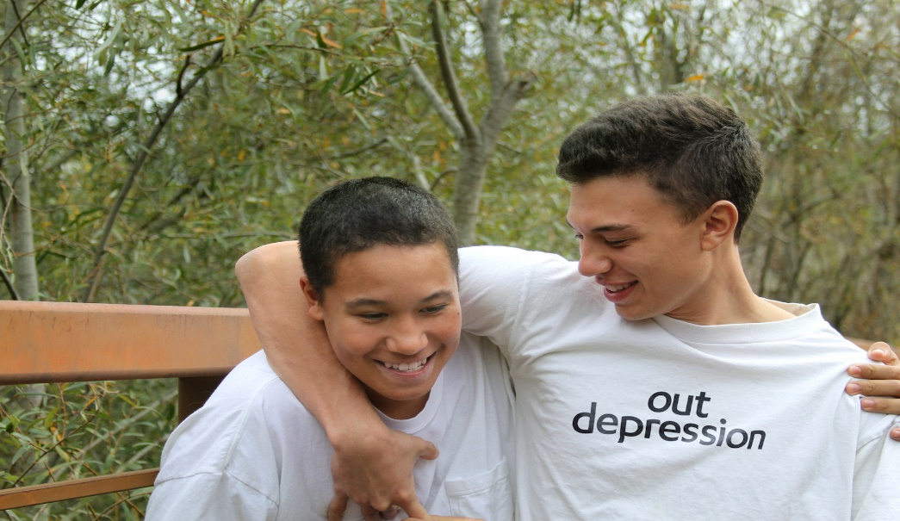
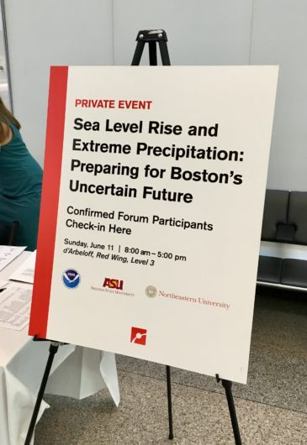
Specific University Examples
Citizen Engagement
Arizona State Consortium for Science, Policy, & Outcomes
UCLA Think Grand
Sustainable LA & Depression
Report on University-Led Grand Challenges

Slide 9
A NEW IDEA:
University FOR Missouri
With a focus on ‘all things Missouri,’ we will deepen the university’s relationship with—and value to—the people of Missouri from Neosho to Hannibal. The struggles facing Missouri communities are challenges that we are ready to tackle.

Slide 10
Nutrition and health
Business and community
Youth and education
STATEWIDE PRESENCE

Slide 11
National Organizations and Funders
Humanities for All is an initiative of the National Humanities Alliance which now showcases over 2,000 examples of publicly engaged humanities work at U.S. colleges and universities. Humanities for All presents the results of a survey of the state of the publicly engaged humanities conducted in 2017-2018 with the support of the Andrew W. Mellon Foundation.

Slide 12
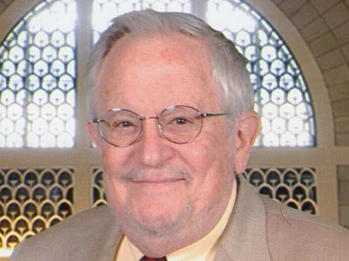
Hauser Policy Impact Fund
National Academy of Sciences, Engineering and Medicine Fund to in honor of former Division of Behavioral and Social Sciences and Education (DBASSE) Executive Director, Robert M. Hauser.
Helps to fund targeted policy briefings, articles and Op-eds in select media, short videos and other communications products, and special symposia to connect the leading social and behavioral scientists with decision-makers.
Hauser argued that the end-point of a National Academies’ committee project is not a ‘report’—it is its impact. Impact, in turn, requires sustained and targeted efforts to reach relevant decision-makers, translation of the implications for a variety of different audiences, and facilitating discourse among researchers, policymakers and practitioners.
https://www.nationalacademies.org/our-work/hauser-policy-fund

Slide 13
Societal Experts Action Network (SEAN)
SEAN is a network of leading individuals and institutions in the social and behavioral sciences who help to facilitate rapid responses to actionable questions from decision-makers.
To assist with COVID-19, SEAN is:
• Coordinating solicitation and responses to practical questions facing federal, state, and local decision-makers that are answerable with SBE evidence;
• Helping identify experts who can respond to queries from government officials; and
• Linking to the National Academies Standing Committee on Emerging Infectious Diseases and 21st Century Health Threats as resources for identifying and answering questions that need SBE sciences expertise, as appropriate;

Slide 14
Federal Programs/ Models that Enhance Impact

Slide 15
Conclusion
Institutional support and leadership from universities, national organizations, and public and private funders will be critical to expanding the impact that SS&H researchers can have in addressing real world challenges and important societal issues.

Slide 16
Contact Me
toby.smith@aau.edu
@SciPolGuy
@AAUnivesities
www.aau.edu

Slide 17
Impact of Social Sciences, Humanities and Arts
13-15 October, 2021
Rick Delbridge
Professor of Organizational Analysis at Cardiff Business School & co-convenor of the Centre for Innovation Policy Research, Wales, UK
#SSHA21

Slide 18
Supporting and leading impact: The Cardiff Capital Region Challenge Fund
Rick Delbridge
Co-convenor of the Centre for Innovation Policy Research
Cardiff University

Slide 19
Some key principles
Place-based approach
‘Fit’ with the specific local context
Develop capabilities and capacity
Nurture networks & communities of practice
Mission-oriented innovation
Centred around societal challenges
Partnership with Cardiff Capital Region
Problem-framing
Co-creation, design & delivery
Notes:
Opportunity for our Region Demonstrate innovation at scale – innovative and radical
Solve BIG challenges for our region
Identify public services problems that solving will help address societal challenges
Innovation in procurement and Procurement of Innovation
Collaboration of public / private sector
Creation of new products and services with commercial potential
Produce radical improvements in service delivery
Stimulate economic benefits for the region and local wealth building

Slide 20
Mission-oriented innovation
A mission-oriented approach uses specific challenges to stimulate innovation across sectors. Through well-defined missions—focused on solving important societal challenges related to climate change and environmental quality, demographic changes, health and well-being, mobility issues, etc.—governments have the opportunity to determine the direction of growth by making strategic investments throughout the innovation chain and creating the potential for greater spillovers across multiple sectors, including low-tech sectors
Mazzucato 2018

Slide 21
Innovation in an increasingly complex and polycentric polity
Context, substance & agents of place-based innovation policy are undergoing rapid change
Context - we are witnessing a more muscular unionism and a new centralism that threatens the territorial integrity of the polycentric polity
Substance – innovation policy is assuming a socio-ecological form as well as a science + technology form
Agents – a new and more heterodox group of agents is emerging in the innovation space, among them coalitions of municipalities

Slide 22
CCR Challenge Programme
£10m
CCR Challenge Fund
£5.6m
Capacity Building Innovative Future Services (InFuSe)
3.5 year programme, building on SBRI approach
Stimulate economic benefits for the region and local wealth building, in part a response to the pandemic
Role for public sector in convening around societal challenges
Produce radical improvements in service delivery
Innovation in Procurement and Procurement of Innovation
Collaboration of public / private sector
Creation of new markets & commercialisation of new products and services
Building capabilities and nurturing an innovation ‘ecosystem’

Slide 23
Cardiff Capital Region Challenge Fund
What is the CCR Challenge Fund?
£10m Challenge Fund is aimed at building local wealth and creating jobs
Bringing together the region’s public and private sectors to develop and deliver novel solutions, and provide a route to market for the solution
CCR Challenge Fund aims:
Solve big societal challenges
Create innovative solutions
Deliver economic impact for the region
Drive commercially scalable opportunities
Three priority themes:
Decarbonisation
Improving health and wellbeing
Transforming communities

Slide 24
Micro-missions: challenge-led innovation themes
Foundational Economy
Food
Supporting, enhancing and transforming communities
Accelerating decarbonisation
Improving health & well-being of citizens
Decarbonisation Buildings & Transport
Public Transport
Public Sector Data
Healthy Ageing
Air Quality
Flood
Supply Chains
Retail & Town Centres
Skills
Health & Well- being

Slide 25
Taking an ecosystem view in building CCR Challenge Fund Support
Investment in creating expertise in the CCR and CU team
Help with Challenge Design including Scoping Problem Space, Selecting Challenge Methodology and Aiding Delivery
Building Peer to Peer support network – Community of Practice
Capacity building through Innovative Future Services programme (InFuSe)
Create a ‘pipeline’ of prospective challenges

Slide 26
The 3Cs of innovation policy in the CCR
Interventions to promote innovation activity across and between clusters
CATALYSTS
COMMONS
CLUSTERS
The ‘raw materials of innovation’:
capabilities
resources
connectivity
Concentrations of
innovative activity
EXAMPLE
Challenge Fund
& Infuse
A catalytic intervention that contributes opportunity, resource, capability and connectivity

Slide 27
Final reflections
A societal challenge focus emphasizes the value of collaboration and inter-disciplinarity
The expertise of social science researchers is valuable (and welcomed)
Innovative and ambitious approaches are needed when it comes to policy (and much more besides)
Are our institutions fit for purpose? ‘Vehicles or mechanisms for impact’?

Slide 28
UK context
Increasing emphasis on regional/subnational policies
Role of UKRI in funding impact activity
Support for PhD students and ECRs
UK Govt ‘levelling up agenda’
A move towards innovation-led research?
Notes:
Opportunity for our Region Demonstrate innovation at scale – innovative and radical
Solve BIG challenges for our region
Identify public services problems that solving will help address societal challenges
Innovation in procurement and Procurement of Innovation
Collaboration of public / private sector
Creation of new products and services with commercial potential
Produce radical improvements in service delivery
Stimulate economic benefits for the region and local wealth building

Slide 29
Many thanks
delbridger@cardiff.ac.uk
Notes:
Opportunity for our Region Demonstrate innovation at scale – innovative and radical
Solve BIG challenges for our region
Identify public services problems that solving will help address societal challenges
Innovation in procurement and Procurement of Innovation
Collaboration of public / private sector
Creation of new products and services with commercial potential
Produce radical improvements in service delivery
Stimulate economic benefits for the region and local wealth building

Slide 30
Impact of Social Sciences, Humanities and Arts
13-15 October, 2021
Antonia Caro Gonzalez
Impact Senior Advisor & Practitioner, Spain
#SSHA21

Slide 31
Impact of Social Sciences, Humanities and Arts
IMPACT SUPPORT AND LEADERSHIP
The Impact Leader
Capacity building for agents of change
Toni Caro, PhD
Entrepreneurial thought leader on social and digital innovation and impact

Slide 33
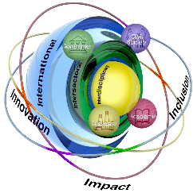
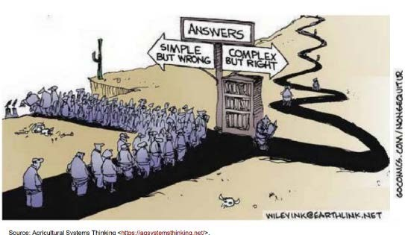
What?
FOR ADDRESSING COMPLEX SOCIETAL CHALLENGES THERE ARE NOT MAGIC RECIPES
Why?
IMPERATIVE NEED FOR DEMOCRATISING INNOVATION
&
BRIDGING THE DEEP HORIZONTAL AND VERTICAL DIVIDES
How?
CAPACITY BUILDING TO DESIGN IMPACT RESEARCH STRATEGIES
tcarogon@gmail.es
3

Slide 34
CROSSING THE BRIDGE FROM RESEARCH AND INNOVATION TO IMPACT

Slide 35
NO MAGIC TRICKS

Slide 36
tcarogon@

Slide 37
tcarogon@gmail.com

Slide 38
.
tcarogon@gmail.es

Slide 40
INTEGRATED VALUE CHAIN TO ENHANCE A CULTURE OF SOCIETAL IMPACT
Demostration trials
Innovation
Scale-up facilitation
Innovation projects
Valuable Solutions
Education, training + co- creation
Research imputs
Knowledge, science
, R&D
Newco / SME Intersectorial collaboration
Tech. Transfer
Market difusion
Innovation value chain
Products & services for clients and patiens

Slide 41
THE 6i+ STRATEGY
The music

Slide 44
The capacity building of impact leaders as agents of change
has never been more important
TO HUMANITY, TO LIFE, TO THIS PLANET.
Thank you!
ancaro@deusto.es

Slide 46
Impact of Social Sciences, Humanities and Arts
13-15 October, 2021
Thank you!
#SSHA21

